Slide 1





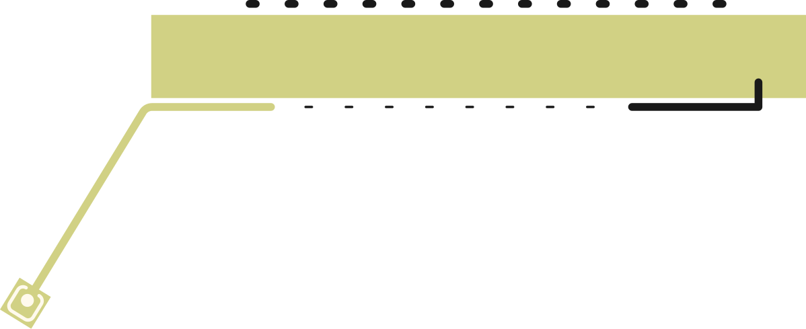


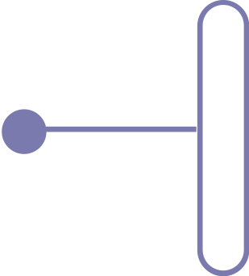

KEYNOTE PRESENTATION
AES
VISUAL
3D Encryption
CRYPTOGRAPHY
ALGORITHM
Presented by Team 404 Found
El-Gamal
RSA

Slide 2





INTRODUCTION
It is an Advanced 3-Dimensional Steganographic Encryption tool. It utilizes the properties of three-dimensional geometric shapes, such as area or volume, to encode secret messages within seemingly ordinary digital media.
This method of encryption provides added security by disguising the existence of the secret message, making it difficult for unauthorized parties to detect its presence.

Slide 3


INTRODUCTION
WHAT?
APPLICATION
TECHNIQUES
The use of 3-D encryption techniques allows for the secure transfer of confidential information while maintaining the privacy and confidentiality of the data being transmitted.
The use of 3-D encryption techniques allows for the secure transfer of confidential information while maintaining the privacy and confidentiality of the data being transmitted.
HexaPrism
OctaHedron
OctaPrism
PentaPrism
PentaPyramid
BASIC INFO

Slide 4


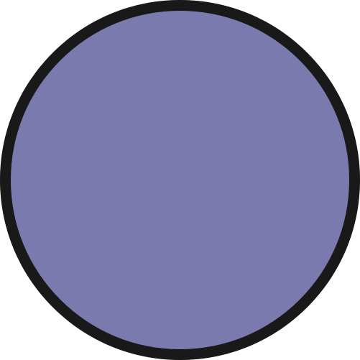


2
ENCRYPTION ALGORITHM
WORKING
The input plain text is encrypted using an encryption algorithm to produce the cipher text.
1
INPUT PLAIN TEXT
The user inputs a plain text message that needs to be encrypted.
The input plain text undergoes verification to ensure that it meets the requirements
3
HIDING CIPHER TEXT
The cipher text is then hidden behind a 4K image using 3-Dimensional Steganographic techniques, making it difficult for unauthorized parties to detect the presence of the secret message.

Slide 5





VISION
RSA + AES
Caeser
cipher
Our vision is to become a leading provider of cutting-edge steganographic encryption technology, continuously innovating and improving our solutions to meet the ever-evolving security needs of our clients, and ensure the privacy and confidentiality of their information.
3D Encryption

Slide 6






MISSION
Our mission is to provide secure and confidential communication for organizations and individuals by developing and delivering advanced 3-Dimensional Steganographic encryption tools that protect sensitive information from unauthorized access.

Slide 7


WHY TO USE 4K RESOLUTION?
RSA
DES
The use of 4K images in VCA provides greater data storage capacity and enhanced security.
The higher number of pixels in 4K images allows for a greater amount of encrypted information to be hidden
The high resolution makes it more difficult for unauthorized parties to uncover the encrypted data, increasing overall security.
Schnorr
AES
DSS
HMAC

Slide 8


CONCLUSION
The tool uses 3D shapes to encode secret messages within digital media, making it difficult for unauthorized parties to detect its presence.
The use of 4K images provides a larger capacity for data storage and enhances security through high resolution.
The encryption process involves inputting plain text, using an encryption algorithm, generating a unique decryption key, and hiding the cipher text behind a 4K image.
The use of 4K images in APDR is a deliberate choice for greater data storage capacity and enhanced security.

Slide 9



MEET OUR TEAM
SHUVAM
ROY
DARSHAN RAWAL
PRIYANSHU NEGI
CIPHER ANALYST
RESEARCHER
DEVELOPER

Slide 10
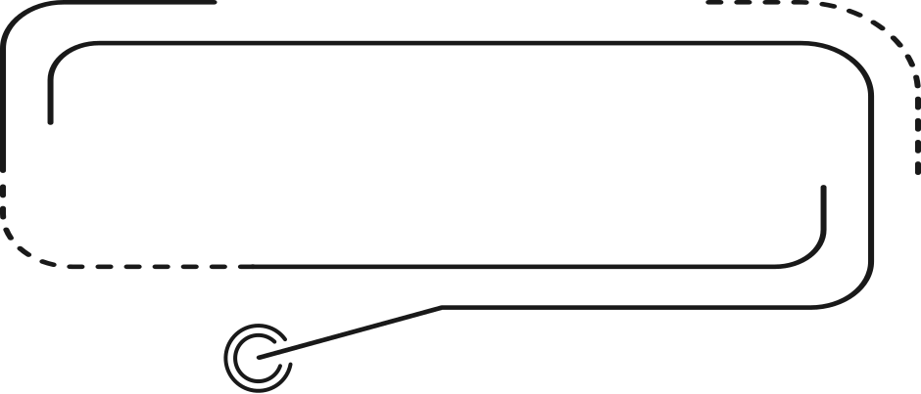
VISUAL CRYPTOGRAPHY ALGORITHM
THANK YOU
Protect what matters,
secure your future

